Slide 1
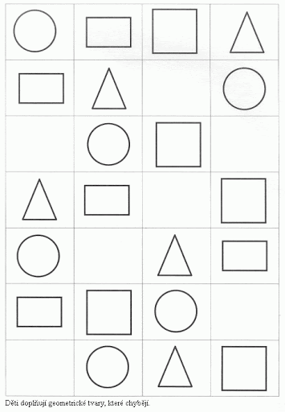

Slide 2
11 + 4 = 15
10 + 1 + 4 = 15

Slide 3
15 + 1 =
11 + 6 =
13 + 5 =
17 + 2 =

Slide 4
18 + 1 =19 12 + 5 = 16
12 + 7 = 15 17 + 1 = 18
13 + 5 = 17 15 + 4 = 18
11 + 6 = 17 14 + 2 = 15
14 + 1 = 15 11 + 4 = 15

