Slide 1

Učebnice str. 50
Poslech:
1 d a
2 b c
3 a b
4 c d

Slide 2
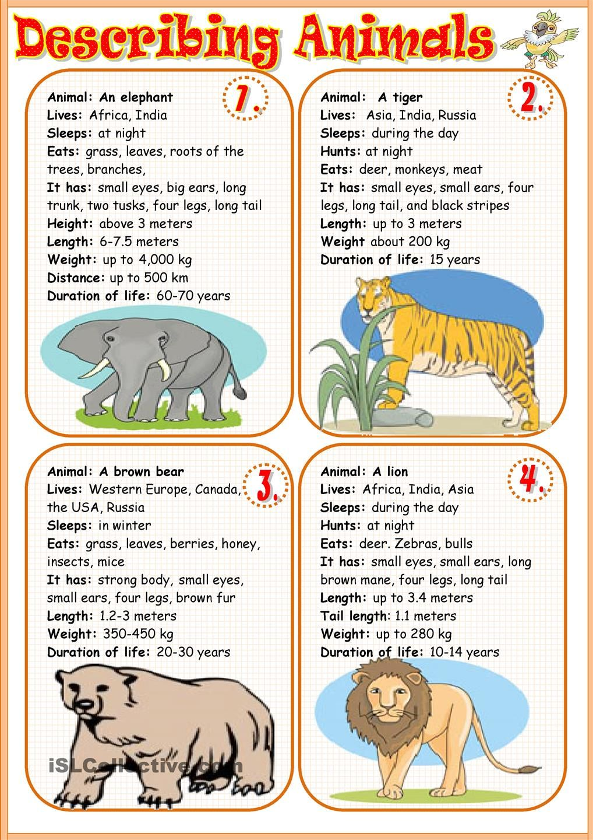
WB str. 50/cv. 6
KONTROLA WB str. 50
Cv. 5 – 1c 2b 3a 4d
Cv. 6 – rivers, big, lives, plants

Slide 3
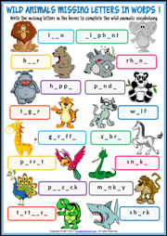
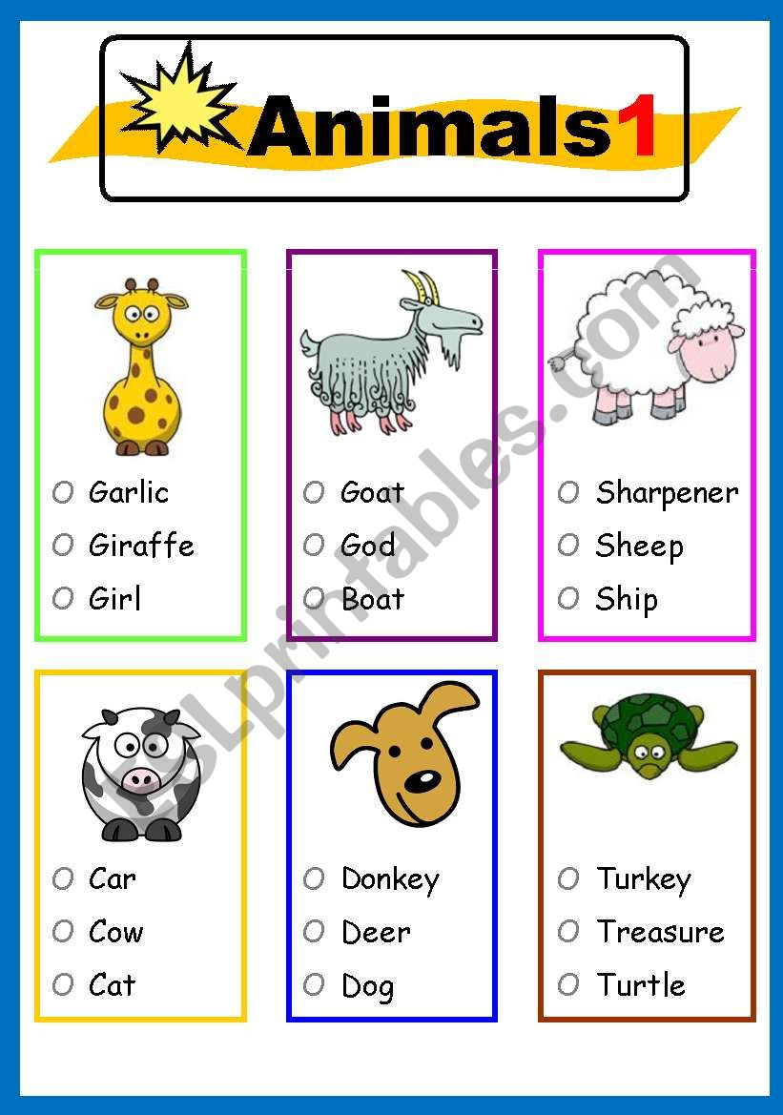
PROCVIČOVÁNÍ:

Slide 4
ZDROJE
Učebnice, pracovní sešit CHIT CHAT 2 Paul Shipton
OBRÁZKY:
https://www.google.cz/url?sa=i&url=https%3A%2F%2Fwww.biolib.cz%2Fcz%2Fimage%2Fid65866%2F&psig=AOvVaw3Zm2yXvzZkVkGyy6xVbQS4&ust=1591209544569000&source=images&cd=vfe&ved=0CAIQjRxqFwoTCPiIsdXj4-kCFQAAAAAdAAAAABAD
https://www.google.cz/url?sa=i&url=https%3A%2F%2Fwww.stoplusjednicka.cz%2Fletajici-lisky-stareho-sveta-kaloni-exoticti-bratranci-netopyru&psig=AOvVaw3Zm2yXvzZkVkGyy6xVbQS4&ust=1591209544569000&source=images&cd=vfe&ved=0CAIQjRxqFwoTCPiIsdXj4-kCFQAAAAAdAAAAABAJ
https://www.google.cz/url?sa=i&url=https%3A%2F%2Fwww.eslprintables.com%2Fvocabulary_worksheets%2Fthe_animals%2FAnimals_for_kids_414718%2F&psig=AOvVaw3Ejayp_tdQd4iuPqgnPIcu&ust=1591301680004000&source=images&cd=vfe&ved=0CAIQjRxqFwoTCNjTj_265ukCFQAAAAAdAAAAABAK
https://www.google.cz/url?sa=i&url=https%3A%2F%2Fwww.englishwsheets.com%2Fwild-animals.html&psig=AOvVaw3Ejayp_tdQd4iuPqgnPIcu&ust=1591301680004000&source=images&cd=vfe&ved=0CAIQjRxqFwoTCNjTj_265ukCFQAAAAAdAAAAABAP

